Slide 1
Web Crawler & Web Scraping

Slide 2
What’s the Difference?
WEB CRAWLER
- A web crawler, spider, or search engine bot downloads and indexes content from all over the Internet
- It involves looking at a page in its entirety and indexing it, including its last letter and dot on the page, in the quest for information
Example: Google, Yahoo or Binge search engines crawl web pages and use the information for indexing the web pages.
WEB SCRAPING
- Web scraping is basically extracting data from websites in an automated manner
- It is automated because it uses bots to scrape the information or content from websites
Example: You would extract the price of various/specific products from Amazon or any other e-commerce site
<number>

Slide 3
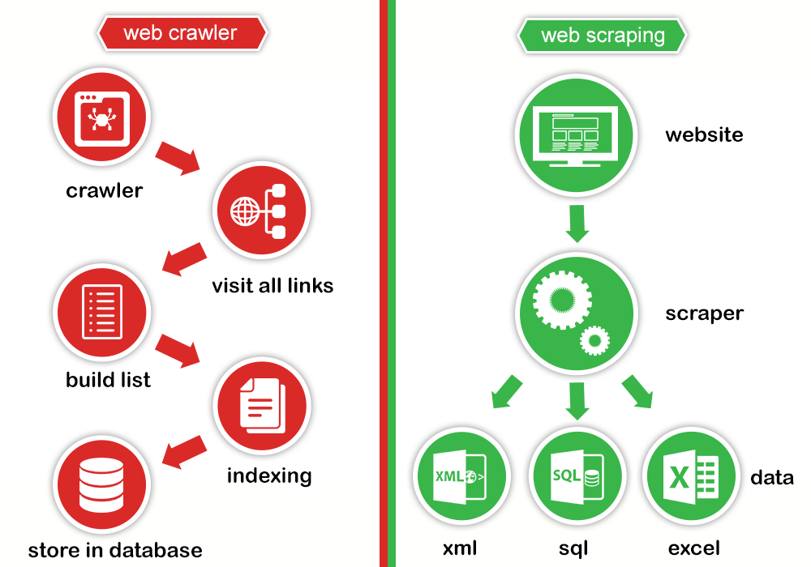
<number>

Slide 4
How Does Web Scraping Work?
1. Request – Response (use Request)
2. Parse and Extract (use BeautifulSoap)
3. Save to csv (use Pandas)
4. Save data into database (use sqlite3)
.
<number>

Slide 5
1. Request - Response
- We use the request.get function to get data from the IMDb page.
response = requests.get(url, "Accept-Language": "en-US")
- Extract the HTML behind it and convert it to a BeautifulSoup object
soap = bs4.BeautifulSoup(page.text, "html.parser")
<number>

Slide 6
2.1 Parse and Extract (NonSelenium)
- We use BeautifulSoap object (soap) can get a list of all distinct movies and their corresponding HTML by:
movies = soap.findAll('div', class_='lister-item-content')
titles = [movie.find('a').text for movie in movies]
releases = [movie.find('span', class_='lister-item-year text-muted unbold').text for movie in movies]
imdb_rating = movie.find('div', 'inline-block ratings-imdb-rating')['data-value']
votes = movie.findAll('span' , {'name' : 'nv'})[0]['data-value']
director = movie.find('p').find('a').text
actors = [actor.text for actor in movie.find('p').findAll('a')[1:]]
descriptions = movie.findAll('p' , {'class' : 'text-muted'})[1].text
<number>

Slide 7
2.2 Parse and Extract (Selenium)
- We can get BeautifulSoap object (soap):
soup_level1 = BeautifulSoup(driver.page_source, 'lxml')
- We will loop every detail link
detail_link = driver.find_element_by_xpath('//a[@href="' + currentSpan.findNext('a')["href"] + '"]')
detail_link.click() #click detail link
- Get BeautifulSoap object for detail page:
soup_level2 = BeautifulSoup(driver.page_source, 'lxml')
- Get IMDb data in detail page by chrome driver:
titles = driver.find_element_by_xpath('//h1[@class=""]').text
releases = driver.find_element_by_xpath('//span[@id="titleYear"]').text
<number>

Slide 8
3. Save to csv
- We create new DataFrame from dictionary multi data (titles, releases, audience_ratings, ...):
df = pd.DataFrame(df_dict)
- Export Pandas DataFrame to csv
df.to_csv("D:\\ExportDocument\\imdb_nonselenium.csv", header=True, index=False)
<number>

Slide 9
4. Save data into database
- We will check exist item, if not exist, create one row in db:
conn = sqlite3.connect(db_file)
cur = conn.cursor()
cur.execute(sql_insert_query, imdb)
- If exist, update exist row in db by Key:
conn = sqlite3.connect(db_file)
cur = conn.cursor()
cur.execute(sql_update_query, (modifiedOn, Key, ))
<number>

Slide 10
Python Demo

Slide 11
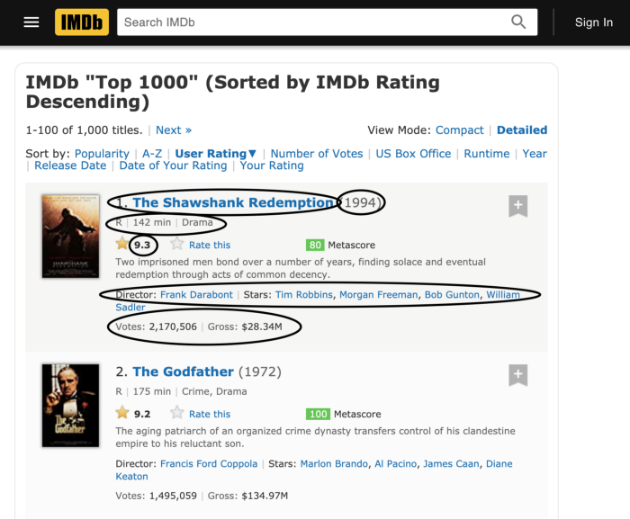
Demo NonSelenium: Get information/data from a website IMDB (https://www.imdb.com)
On list page, get information as below:
Title
Release Year
Runtime
Audience Rating
Genre
IMDB Rating
Number of Votes
Director
Actors
Description
<number>

Slide 12
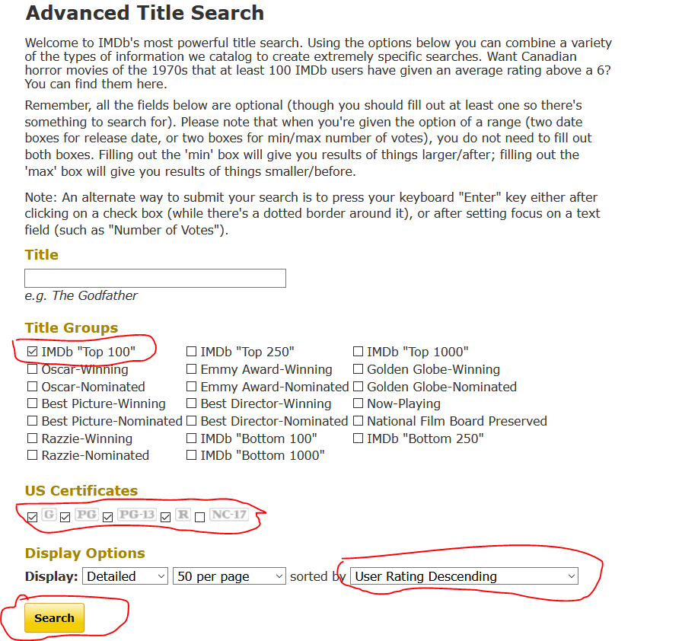
Demo Selenium (https://www.imdb.com/search/title/)
On Search page, Selenium will auto:
Check IMDb “Top 100” (Title Group)
Check “G”, “PG”, “PG-13”, “R” (US Certifications)
Select User Rating Descending (sorted by)
After check and select click “Search” button
.
<number>

Slide 13
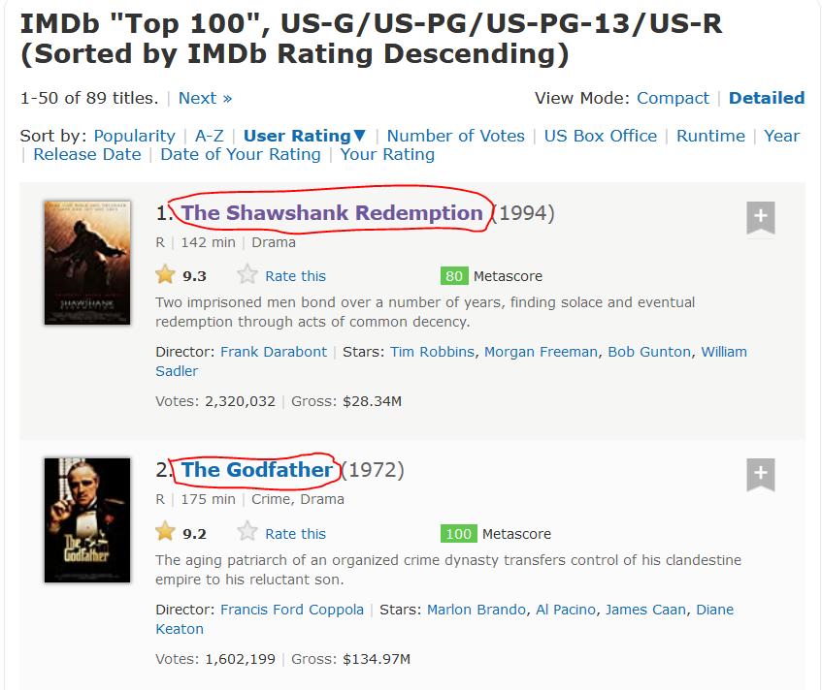
Demo Selenium (cont.)
On list page, Selenium will do:
Click every detail link
Wait for get info and return this page
.
<number>

Slide 14
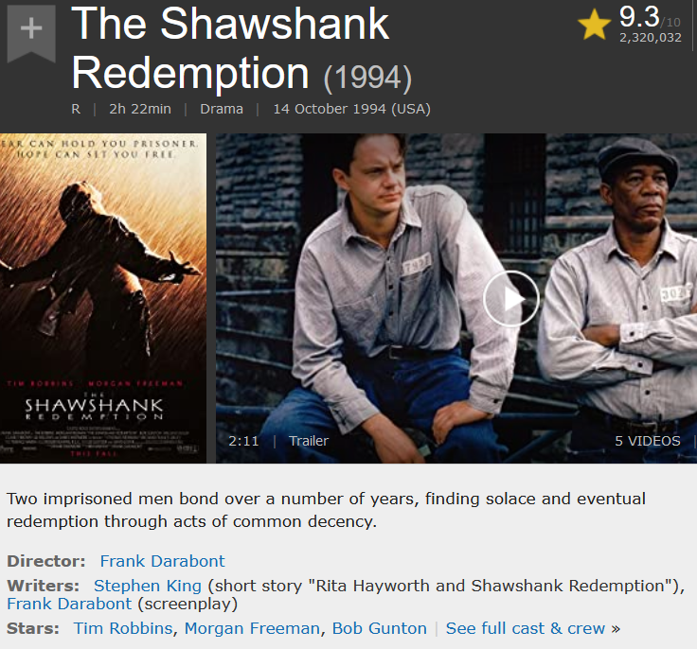
Demo Selenium (cont.)
On Detail page, Selenium will auto:
Get title “The Shawshank Redemption (1994)”
Get release “(1994)”
Get audience rating “R”
Get Runtime “2h 22min”
Get Genre “Drama”
Get Imdb rating “9.3”
Get Votes “2,319,662”
Get Director “Frank Darabont”
Get Actors “Tim Robbins, Morgan Freeman,..”
Get Descriptions “Two imprisoned ….”
And return to list page
.
<number>

Slide 15
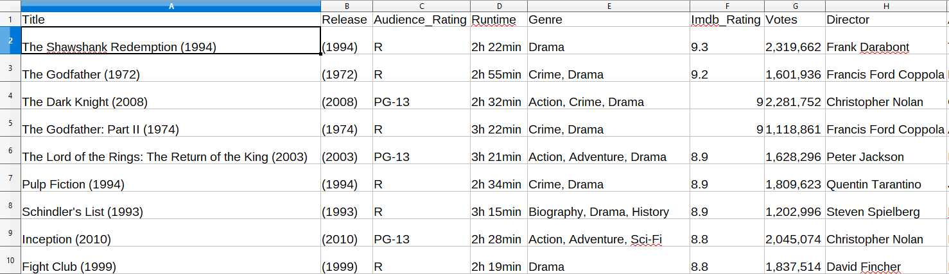
Download Data (save to csv)
- Csv file has structure as image:
Title
Release
Rating
Runtime
Genre
Imdb_Rating
Votes
Director
Actors
Description
- With NonSelenium, file name is “imdb_nonselenium_1.csv”, “imdb_nonselenium_2.csv”,…
- With Selenium, file name is “imdb_selenium.csv”
.
<number>

Slide 16
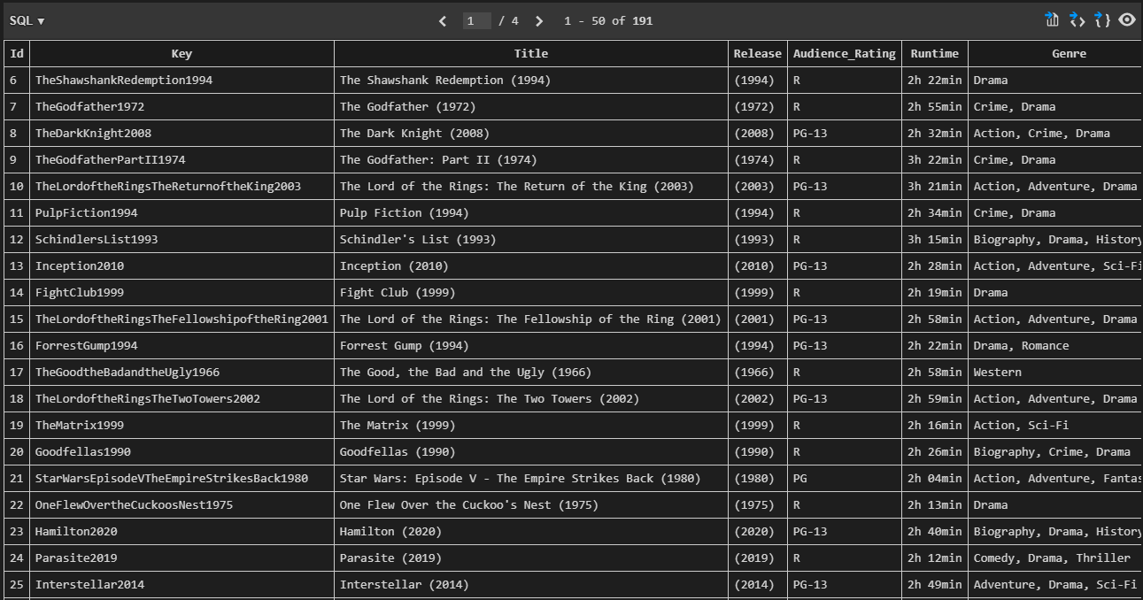
Save data into database
- Table IMDb has structure like csv file but have some different:
Key: unique value, use for update
Created_On: date of create row data
Modified_On: date of modify exist row data
.
<number>

Slide 17
Reference
Beautiful Soup: https://pypi.org/project/beautifulsoup4/
Python Requests Module: https://pypi.org/project/requests/
Python Data Analysis Library: https://pandas.pydata.org/
Convenient Web-browser controller: https://docs.python.org/3/library/webbrowser.html
Regular expression operations: https://docs.python.org/3/library/re.html
Selenium with Python: https://selenium-python.readthedocs.io/
Miscellaneous operating system interfaces: https://docs.python.org/3/library/os.html
Common pathname manipulations: https://docs.python.org/3/library/os.path.html
DB-API 2.0 interface for SQLite databases: https://docs.python.org/3/library/sqlite3.html
<number>

Slide 18
thanks!
Any questions?
You can find me at
Email: tpbao@tma.com.vn
Skype: tranphucbao
<number>

